Slide 1


Introducing Core Solidity
Argot Collective
Notes:
Hi! My name is Rodrigo Ribeiro and I’m researcher at Argot Collective.
Today, I’ll talk about my work in Core Solidity Project.

Slide 2
Introduction
Solidity,today
Most used smart contract language
Successfully secures billions of dollars
However, it has some limitations:
  Type system lacks expressiveness
  Does not support compile time eval.
Extending the current impl. is hard.
Notes:
Solidity is world most used smart contract development language.
It is robust and secure billions of dollars of value.
We are proud of it’s history of secure code generation, but users are aware of it’s limitations:
* The type system is not expressive enough to express safety properties or to produce reusable library code
* The language does not support compile time evaluation.
Fixing these limitations within the current implementation is hard. The addition of new language features is made in a ad-hoc way, which makes maintainability and reasoning about correctness difficult.

Slide 3
Introduction
What is Core Solidity?
A complete rebuild of the language type system and compiler pipeline.
Introduce new features
A formal semantics to enable analysis and verification.
Notes:
In order to solve these issues, the Argot collective started a complete rebuild of the language type system and it’s compiler pipeline.
This rebuild is what we call Core Solidity.
Core Solidity will introduce new language features and it will have a formally verified semantics, that can be used to enable static analysis and formal verification of application code.

Slide 4
Introduction
Core Solidity
New features
Generics and type classes (traits)
Algebraic data types and pattern matching
Type inference
High-order and anonymous functions.
Compile time evaluation.
Notes:
We extended Solidity with the following features:
1. Generics and type classes
2. Algebraic data types and pattern matching.
3. Type inference.
4. High-order and anonymous functions
5. Compile time evaluation.
Let’s take at look in some examples of these features.

Slide 5
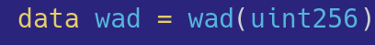
Core Solidity New Features
Algebraic data types
Data type for representing a 18 decimal fixed point
Notes:
Algebraic data types allows data modelling by composing sum and product types in a simple, principled way.
In this example, we have the definition of a wad, a type for representing a 18 decimal fixed point number.

Slide 6
Core Solidity New Features
Algebraic data types
Type name
Constructor name
Data type for representing a 18 decimal fixed point
  Constructors and type names live in different namespaces
Notes:
Each algebraic data type defines a type name and a set of data constructor names to build values of the newly declared type.
In this example, we have that the wad type has a unique constructor which holds a uint256 value.

Slide 7
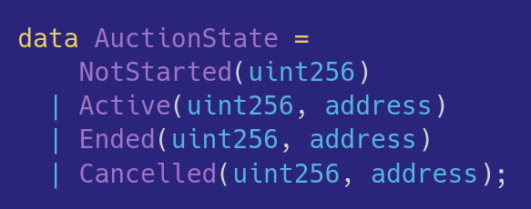
Core Solidity New Features
Algebraic data types
Allows data modelling using sum and product types.
Notes:
Algebraic data types allow the definition of different data constructors to represent alternative ways of creating values of the type.
As an example, consider a type for modelling an auction state which can be one of 4 different possibilities.

Slide 8
Core Solidity New Features
Algebraic data types
Type name
Sum types/Alternatives
Sums allows the definition of exclusive alternatives in a type.
Notes:
Each constructor provides a different way for building values of the type.

Slide 9
Core Solidity New Features
Algebraic data types
Type name
Product type
Products combine values into structured tuples.
Notes:
Product types allow constructors to store tuple of values of possibly different types. As an example, Cancelled constructor holds an uint256 and address.

Slide 10
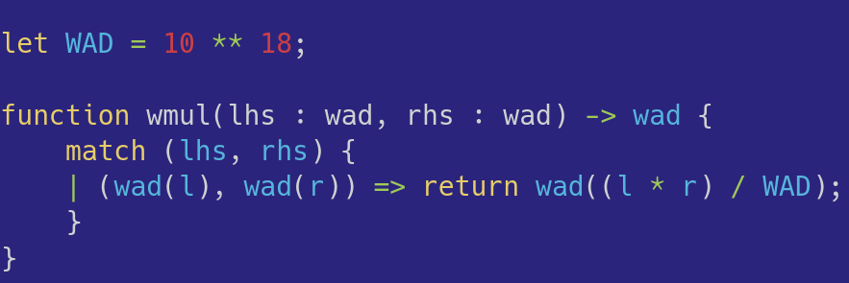
Core Solidity New Features
Pattern Matching
Pattern matching allows changing control flow based on value shape.
Notes:
The true expressivity of algebraic data types comes together with pattern matching, that allows the change of control flow based on the shape of the matched value.

Slide 11
Core Solidity New Features
Pattern Matching
Pattern match block
Notes:
Pattern matching is built around match blocks.

Slide 12
Core Solidity New Features
Pattern Matching
Discriminee
Notes:
Which holds a discriminee, the value with will be analysed in the block. In this example, a pair of wad values.

Slide 13
Core Solidity New Features
Pattern Matching
Wrapped uint256 values
Notes:
And the match block can have a series of blocks which will be selected based on the shape of the discriminee.
Each block allows the introduction of new values in the scope by variables that appear in the pattern.
In this example, we can retrieve the wrapped uint256 values of the wad arguments.

Slide 14
Core Solidity New Features
Pattern Matching
Wrapping result in
data constructor
Notes:
And use these newly introduced values to build the result.
Since we want to produce a wad value, we need to wrap it using the data constructor for this type.

Slide 15
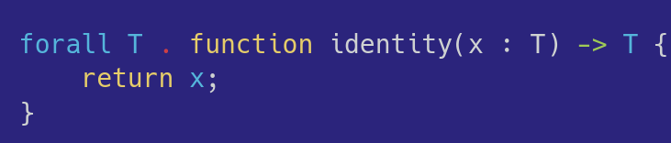
Core Solidity New Features
Generics
Generics allows functions that work in a uniform way for all types.
Example: polymorphic identity function.
Notes:
Generics, also know as parametric polymorphism, allows the definition of functions that work in a uniform way for all types.
Here, we have an example of the polymorphic identity function.

Slide 16
Core Solidity New Features
Generics
Type variable definition.
Parameter type.
Generics allows functions that work in a uniform way for all types.
Example: polymorphic identity function.
Notes:
It defines a type variable, named T, which is scoped through all function definition.
Here, we use it on the function argument type and return type.

Slide 17
Core Solidity New Features
Generics
Type variable definition.
Function return type.
Generics allows functions that work in a uniform way for all types.
Example: polymorphic identity function.
Notes:
It defines a type variable, named T, which is scoped through all function definition.
Here, we use it on the function argument type and return type.

Slide 18
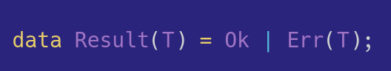
Core Solidity New Features
Generics
Core supports the definition of generic types
  Type parameter for the payload used in Err constructor
Notes:
Since we allow polymorphic function, we also need a way to define polymorphic user defined types.
Algebraic data types allows the definition of polymorphic types by adding type parameters to their definitions

Slide 19
Core Solidity New Features
Generics
Type parameter definition
Core supports the definition of generic types
  Type parameter for the payload used in Err constructor
Notes:
Type parameters are defined together with the type name

Slide 20
Core Solidity New Features
Generics
Type parameter use
Core supports the definition of generic types
  Type parameter for the payload used in Err constructor
Notes:
And type parameters can be mentioned in the data type constructors. In this example, we have that the Error constructor can hold a value of type T as its payload.

Slide 21
Core Solidity new features
Generics and
Type classes
Generics are a bit limited.
  Few functionality works for all types.
We need functionality which works for some types.
Type classes are the solution!
  Allow the systematic combination of generics and overloading.
Notes:
While interesting, generics are limited because very few functionality works for all types.
Most useful operations need to work for some types.
Type classes are the solution for this: they allow the systematic combination of generics and overloading in programming languages.

Slide 22
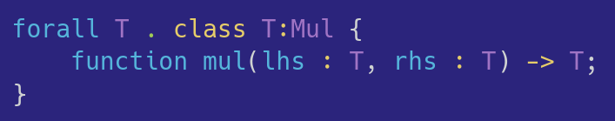
Core Solidity New Features
Type classes
Type classes define a set of operations with their types.
  Example: class for defining a multiplication operation
Notes:
As an example, let’s consider the following declaration of a type class for types that support a multiplication operation.

Slide 23
Core Solidity New Features
Type classes
Class name
Type classes define a set of operations with their types.
  Example: class for defining a multiplication operation
Notes:
A type class introduces a class name

Slide 24
Core Solidity New Features
Type classes
Type argument
Function signature
Notes:
And type arguments which can be used in its member function signatures to define its type.
In this example, function mul takes two arguments of type T and returns a T value.

Slide 25
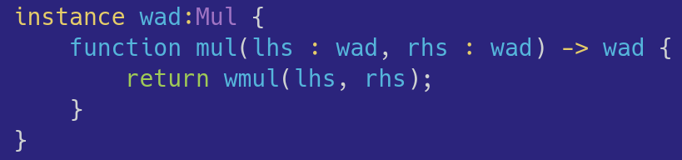
Core Solidity New Features
Type classes
Type argument
Instances provide an implementation for a specific type.
  Function types should “replace” the class type argument for the corresponding concrete type.
Notes:
Implementations of overloaded definitions are provided by instance declarations. In instance definitions, type variable arguments are replaced by the concrete type that we are giving an implementation.

Slide 26
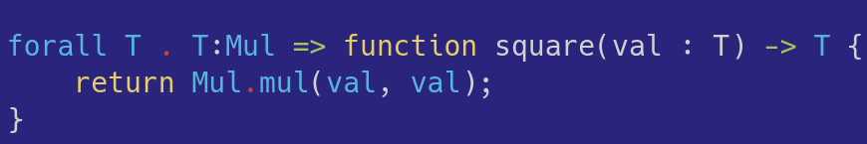
Core Solidity New Features
Type classes
Type class constraint
Type class constraints allow us to restrict polymorphic types.
  Function square can be called on all types which are instances of Mul.
Notes:
Type classes allow the usage of constraints, which restrict the usage of polymorphic types to the ones which are instances of the refereed type class.
In this example, we have a function called square, which works for any type T that is an instance of Mul type class.

Slide 27
Core Solidity new features
High-order and
anonymous
functions
Functions are first-class in Core Solidity.
This means that they can be used:
  Function parameters
  Return values
Notes:
Another features included in Core are high-order and anonymous functions.
With them, functions are now first-class citizens in Core Solidity, which means that they can be used as arguments and return values of functions.

Slide 28
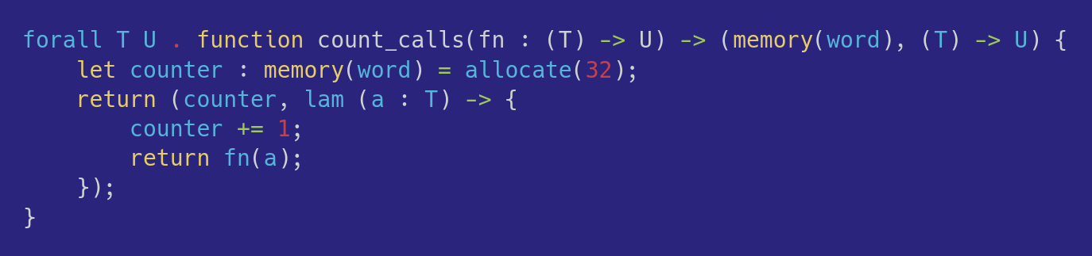
Core Solidity New Features
Anonymous functions
Anonymous functions are defined using the lam keyword.
  Can capture values of their definition scope.
  Example: count the number of times which an argument function is called.
Notes:
Let’s consider the usage of these features to build a utility which can be used to count the number of times a given function is called.

Slide 29
Core Solidity New Features
Anonymous functions
Anonymous function definition
Anonymous functions are defined using the lam keyword.
Notes:
Anonymous functions definition starts with the lam keyword, followed by its arguments and body which can capture values of their definition scope.

Slide 30
Core Solidity New Features
Anonymous functions
Captured value
Anonymous functions are defined using the lam keyword.
  Can capture values of their definition scope.
Notes:
As an example, counter variable is capture inside the anonymous function definition.

Slide 31
Core Solidity New Features
High-order functions
Function type
Type (T) → U represents a function
  That takes a value of type T as argument.
  Returns a value of type U.
Notes:
Function types are curried, so a n-argument function type is represented by a tuple of n-arguments followed by an arrow and the return type.

Slide 32
Core Solidity new features
Type inference
Core Solidity infers types in functions and local variables.
Annotations are required only to solve ambiguities.
  Occur in very rare situations.
Can help readability by omitting unnecessary type annotations.
Notes:
Core Solidity type system allows for a type inference algorithm.
Most of type annotations are optional.
Required annotations are only necessary to solve ambiguities, which happen rarely.

Slide 33
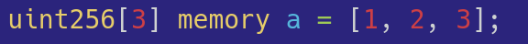
Core Solidity New Features
Type inference
Consider this simple Classic Solidity definition.
Notes:
As an example, of the usefulness of type inference, consider the following simple array definition in Classic Solidity.

Slide 34
Core Solidity New Features
Type inference
It is rejected with the following error message:
Error: Type uint8[3] is not implicitly convertible to type uint256[3].
Notes:
It is rejected by the compiler which returns an error message that says that uint8 is not convertible to uint256

Slide 35
Core Solidity New Features
Type inference
Classic Solidity has a limited support for inferring the type of array literals.
  Elements have the type of the first expression such that all other elements can be casted to it.
Inferred type for the first element: uint8
Notes:
This happens due to the limited support for infering types for array literal elements.
The rule used says that the array has the type of the first expression such that all other elements can be casted to.
In this example, all elements have type uint8.

Slide 36
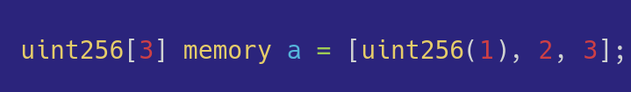
Core Solidity New Features
Type inference
Solution: use a type coercion on the first array element.
Notes:
We can make the compiler happy by adding a typing coercion to the array first element.
However, in our view, this type annotation is unnecessary, since the variable definition already has declared the array (and its elements) type.

Slide 37
Core Solidity New Features
Type inference
In Core Solidity, this definition is accepted
  Thanks to type inference, which uses a more general strategy which eliminates the need of the type coercion.
Notes:
Thanks to the constraint based type inference algorithm used by Core Solidity, this example is accepted without the need of using any type coercion.

Slide 38
Extended Example
Extended example
Core Solidity introduces several new features.
How those features help?
Notes:
We have seen a lot of new features present in Core Solidity.
However, developers might be asking: how these features would help me?

Slide 39
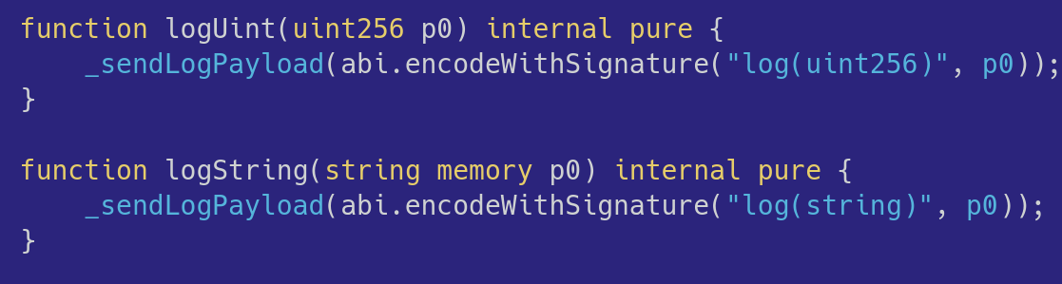
Extended Example
Console.log
Library forge-std implementation has a combinatorial explosion of overloaded functions.
  More than 30 different functions, one for each argument type.
Notes:
Let me show an example.
Consider the implementation of forge-std Console.log library.
Since classic does not support Generics and overloading a proper way, the library has more than 30 different overloaded functions that does
The same thing: call function _sendLogPayload with its input arguments.

Slide 40
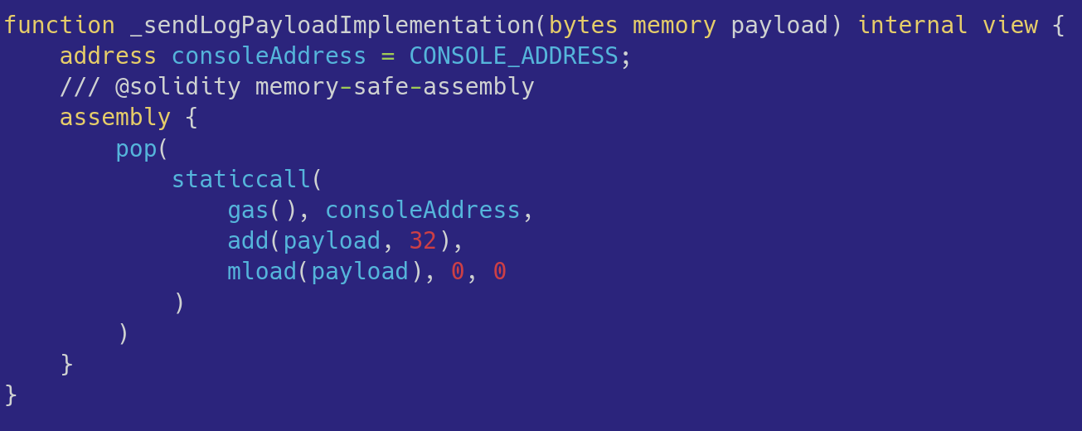
Extended Example
Console.log
Log functions just redirect to _sendLogPayloadImplementation.
Notes:
And function _sendLogPayloadImplementation uses an assembly block to make a static call to a specific address.

Slide 41
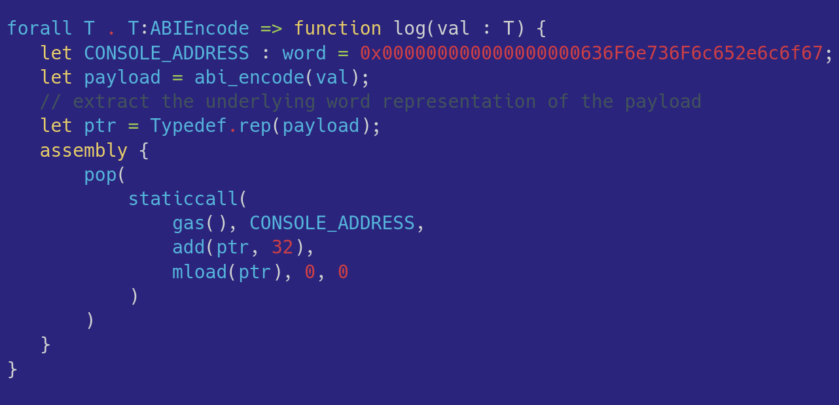
Extended Example
Console.log – Core Solidity
Generics and type classes eliminate all repetitive definitions!
Notes:
In Core Solidity, we can build the same functionality using a single polymorphic definition.
In this way, we can eliminate the more than 30 repetitive function definitions.

Slide 42
Extended Example
Console.log – Core Solidity
ABI encode constraint
ABI encode argument
Generics and type classes eliminate all repetitive definitions!
Notes:
We achieve this generality by using a type class for ABIEncoding and restrict the log value to work only on type which implements it.
Function starts by encoding the input argument.

Slide 43
Extended Example
Console.log – Core Solidity
Convert to assembly
level representation.
Generics and type classes eliminate all repetitive definitions!
Notes:
Next, we use another overloaded function to convert the payload value into a assembly level representation.
Assembly code can mention only values of a specific low level type called word, which is essentially the type of a Yul variable.
Finally, we just make the static call using the same assembly block.

Slide 44
SAIL, desugaring and standard library
SAIL,desugaring
and standard
library
SAIL is a new mid-level IR for Core.
  Solidity Algebraic Intermediate Language.
Features
  Functions and contracts
  Algebraic types and pattern matching
  Assembly blocks
  Type classes and generics
  Variable introduction and assignment.
  Short-circuiting if-then-else expression.
Notes:
One of the motivation for the Core Solidity project is to make the new language more expressive, safer and easy to include new features.
In order to achieve such requirements, we designed a new mid-level IR called SAIL, which stands for Solidity Algebraic Intermediate Language.
This language is the minimum language which supports
* Functions and low level contracts
* Algebraic types and pattern matching
* Type classes and generics
* Variable introduction and assignment
* Short-circuiting if-then-else expression

Slide 45
SAIL, desugaring and standard library
SAIL, desugaring
and standard
library
Core Solidity high-level constructs will be implemented by a combination of desugaring steps and std-lib definitions.
Similar approach used in proof assistants like Lean.
Objective: RFC style for language and std-lib changes
Notes:
The idea is that all high-level Core Solidity features will be implemented by a combination of desugaring steps and standard library definitions.
This is similar to other languages used in high-assurance domains like the Lean theorem prover.
Our ultimate goal with this design is to evolve the language to reach RFC style approach for the language and standard library changes.

Slide 46
Compatibility and interoperability
Compatibility and
interoperability
Introducing major reviews to a language is challenging.
We plan a smooth transition to avoid language split.
  ABI compatibility will be maintained.
  We’ll try to minimize syntax changes.
  Investigate tooling for automated migration.
Notes:
Since we are dealing with a major review in a programming language, avoiding a language split is a must.
We have this in mind and we
* Will keep ABI compatibility
* The syntax chosen in the examples is not final and we will try to minimize syntax changes as much as possible
*We plan to develop tooling for automated migration between classic and core solidity contracts, whenever possible.

Slide 47
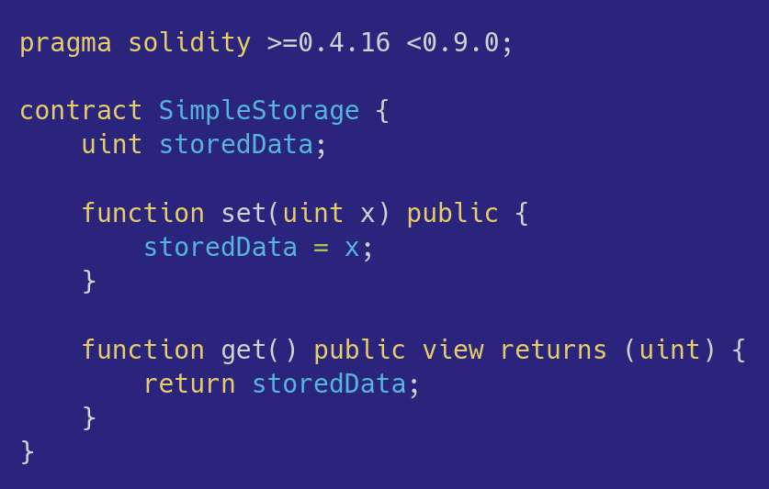
Compatibility and interoperability
Simple Contract – Classic Solidity
Notes:
As a more concrete example, let’s consider the following simple contract definition present in Classic Solidity documentation.
It just defines a storage variable and provide a get and set function for it.

Slide 48
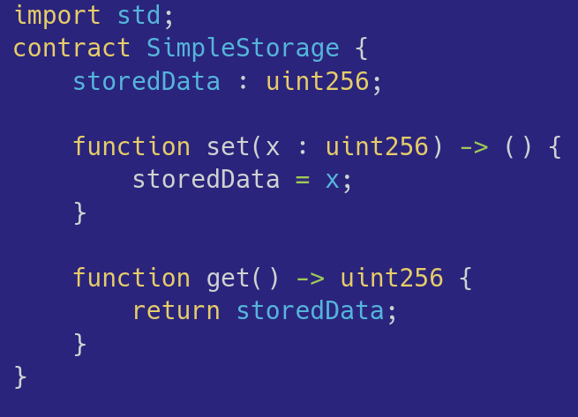
Compatibility and interoperability
Simple Contract – Core Solidity
Minimal changes: postfix types, import of standard library.
Notes:
The Core Solidity version for this contract is almost the same except for:
* usage of postfix types
* changes to function signature return type

Slide 49
The road to production
The road to
production
Prototype implementation available.
Standard library has implementations of:
  ABI compatible contracts
  ABI encoding / decoding
  Dispatch
  Storage access.
Current prototype is able to compile a ERC20 contract.
Notes:
Currently, we have a prototype implementation of the Core Solidity compiler which is able to compile code down to Yul.
We also have built a prototype standard library using it. The library has implementations for:
* ABI compatible contracts.
* ABI encoding / decoding
* Dispatch generation
* Storage access.
Current prototype is able to compile a ERC20 contract using std-lib constructs.

Slide 50
The road to production
The road to
production
Next steps (finish type system):
  Define compile time evaluation.
  Module system.
Prototype stable:
  Start a production implementation.
  Mechanize the meta-theory using a proof assistant.
Notes:
Our next steps will involve
* Define compile time evaluation, which is fundamental to achieve reasonable efficiency.
* Define a module system
As soon as the prototype get stable, our work will be divided into two fronts:
* Start a production implementation, using some system language like C++ or Rust.
* Mechanize the meta-theory of the language, using a proof assistant

Slide 51
Beyond 1.0
Beyond 1.0
Our focus: deliver the language described so far.
Possible future iterations:
  Linear types.
  Refinement types.
  Macros
  Theorem proving
Notes:
We have a lot to do, but our primary goal is to deliver the language as it was described so far.
But we have some cool extensions in mind:
* Adding linear types, which will allow compiler checked resource control, that will be very useful in the context of applications built using solidity.
* Adding refinement types, which will allow users to define properties of their code. Such properties can be verified by an SMT solver.
* Since language extensibility is one of the concerns that give rise to the Core Solidity project, one possible future direction is to add macros to allow new high level constructs to be implemented as libraries that provide syntax that desugars into SAIL code.
* Finally, one possible direction is to look at system languages with theorem proving capabilities like ATS or Bedrock 2.

Slide 52
Conclusion
Conclusion
Core Solidity is a foundational re-imagining of the language.
Our objective is to build a language:
  More expressive.
  More secure.
  Mathematically sound.
Notes:
Concluding, this is our re-imagination of the Solidity language which focus on make it:
* More expressive
* More secure
* Mathematically sound

Slide 53


Thanks!
Core Solidity
repository
Thanks!
Core Solidity
feedback
forum thread
Notes:
Thanks for your attention and here are the QR codes for the Core Solidity prototype repository and its feedback forum thread. We would love to hear your opinions and suggestions to help us to shape the future of smart contract development.

